Slide 1



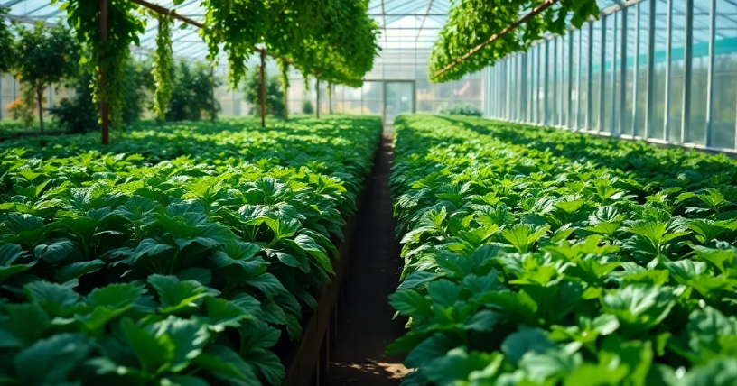


2025/2028
IKHWEZI FARM BUSINESS PLAN
IKHWEZI FARM GREENHOUSE FARMING
Plot 83, 359 JR
Boschkop
oo56
.
s_sabela@hotmail.com
1

Slide 2
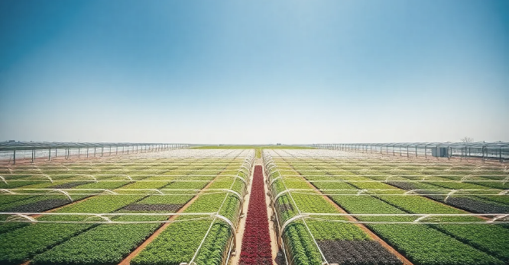

Ikhwezi Farming Business Plan
Prepared By:
Prepared For:
22 On Sloane
Bryanston., Johannesburg,
SA 2000
info@22onsloane.com
Ikhwezi Greenhouse Farming
1st Floor, 101 Commissioner St., Johannesburg, SA 2001
info@ikhwezi.co.za

Slide 3

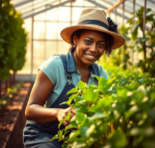


Business Plan
May 05, 2025
Table of Contents
2

Slide 4

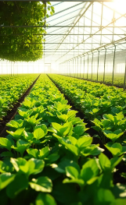
Business Plan
May 05, 2025
Executive Summary
Ikhwezi Farm aims to lead in high-value greenhouse vegetables, building on its quality and community focus. Now entering a key growth phase, it outlines its mission, expansion goals, funding needs, and financial outlook, highlighting its value to investors committed to inclusive, sustainable agribusiness in South Africa.
1.1 Business Overview
Ikhwezi Farm, a black woman-owned, disabled-led agribusiness in Pretoria, specializes in greenhouse vegetables. Founded in 2005, it serves top clients like Woolworths and Pick 'n Pay. Led by Global GAP-certified Ms. Sindisiwe Sabela, it re-registered in 2022 to focus on tech growth, market expansion, and social impact.
1.2 Mission and Vision
Compelling and inspiring mission and vision statements are imperative to propel the company's activities and plans. They also communicate Ikhwezi Farm's role and values to stakeholders like employees, customers, and financiers.
Mission:
To be at the leading edge of greenhouse farming, supplying healthy, high-quality vegetables to both domestic and export markets and contributing to communities in terms of jobs, training, and supporting sustainable farming.
Vision:
To use state-of-the-art greenhouse technology and sustainable farming methods to grow healthy, high-quality produce year-round, contributing to South Africa's food security and socioeconomic development.
3

Slide 5

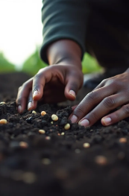
Business Plan
May 05, 2025
Executive Summary
1.3 Key Objectives
Ikhwezi Farm's objectives are stated with the aim of enhancing business sustainability, market leadership, and measurable social return. They reflect the desire to grow while maintaining focus on quality, innovation, and community empowerment. The objectives also provide a distinct direction for business performance and investment distribution.
The most significant objectives for the subsequent three to five years are:
• Restore and upgrade greenhouse facilities to international levels.
• Re-establish high-end retailer supply contracts and expand market
penetration.
• Global GAP re-certification in year one of operations.
• Train and employ local youth and women from the surrounding community.
• Sustain long-term revenue growth through additional production capacity
and value-added product innovations.
1.4 Funding Request Summary
Ikhwezi Farm seeks strategic financial investment to support its revitalization, infrastructure upgrades, and production expansion. The company is requesting R [to be determined] to modernize tunnels, irrigation networks, packhouse facilities, and water infrastructure, including borehole equipment. The funding will also cover farming equipment, planting material, and the hiring and training of specialized staff. The request is supported by existing fixed assets, founder equity, a technology partner’s investment, and demonstrated demand from current and new customers.
4

Slide 6
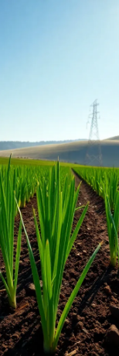

Business Plan
May 05, 2025
Executive Summary
1.5 Summary of Financial Projections
Robust financial projections are essential in indicating the potential of the farm for growth and success. They give funders confidence that the business plan is realistic, achievable, and will be able to yield a return on investment. The most critical projections over the next few years are:
Break-even point: Expected within the first 9 months of operation.
Profitability in Year 1: Anticipated based on confirmed market demand.
Annual revenue growth: Projected at 10% per year.
Operational cost management: Aiming for no more than 20% growth in costs.
Efficiency gains: Starting in Year 2 with in-house seedling production.
1.6 Value Proposition for Investors/Funders
To funders and investors, Ikhwezi Farm offers more than financial returns. An investment in the farm is also an investment in tangible social and economic progress. With its mix of profitability, growth potential, and community gains, Ikhwezi Farm is an attractive investment prospect.
5

Slide 7

Business Plan
May 05, 2025
2. Company Profile
Ikhwezi Farm is not just an agribusiness; it is a case of strength, innovation, and the potential of agribusiness as a vehicle for societal change. The business profile reflects its glorious history, unique ownership, and visionary guidance. This section provides a detailed description of the business history, legal structure, assets, and management that contribute to its competitiveness and long-term sustainability.
2.1 History of the company
Ikhwezi Farm began in 2005 as four other females and Ms. Sindisiwe Sabela created the Ikhwezi Cooperative to address Pretoria's demand for sustainable profits. Overcoming physical disability, Ms. Sabela spearheaded the cooperative towards becoming an early black, woman-owned agricultural company to supply excellence-class vegetables and herbs to market-leading South African retailers Woolworths and Pick 'n Pay. The farm was renowned for premium vegetables and herbs and attained Global GAP status, which is an indicator of its compliance with global agricultural standards of excellence.
The business shut down in 2015 because of Ms. Sabela's poor health. Nevertheless, after some time of recovery, the founder reopened the company under the name Ikhwezi HR Training & Consulting (PTY) Ltd in 2022. The re-registration was a strategic step towards new greenhouse cultivation with ambitions for sustainable growth, increased market penetration, as well as increased social contribution.
6

Slide 8
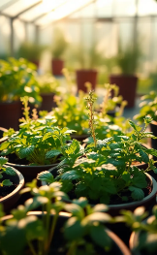
Business Plan
May 05, 2025
2. Company Profile
2.2 Legal Structure and Ownership
Ikhwezi Farm prioritizes strong governance, succession, and empowerment, operating as Ikhwezi HR Training & Consulting (PTY) Ltd, a registered private entity in South Africa. It is 100% black woman- and differently-abled-owned, qualifying it for various government and private sector support programs.
The business is owned by Ms. Sindisiwe Sabela and her daughter, Kuhle, with Ms. Sabela actively mentoring Kuhle as a future leader. This approach supports long-term business continuity and the development of future generations of farmers.
2.3 Location and Facilities
Ikhwezi Farm is positioned strategically in Pretoria on a freehold-owned 8.65-hectare land by its founder. The site allows for convenient access to Gauteng's large markets, reducing cost of logistics as well as increasing market responsiveness.
The farm has the following facilities:
• A five-spanned greenhouse with an area of 5,760 m²
• Eight tunnels with 2,400 m² of production area.
• A Global GAP-compliant packhouse requiring minimal repairs.
• Three secured-water-right boreholes and a reservoir upgrade planned.
• There is also an additional 1-hectare net-house to be developed in the current business plan.
This physical infrastructure forms the foundation of the productive capability of the farm and a good foundation for expansion.
7

Slide 9
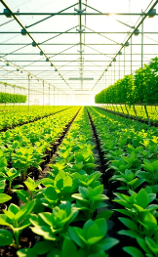
Business Plan
May 05, 2025
2. Company Profile
2.4. Management Team and Key Personnel
Ikhwezi Farm is led by Ms. Sindisiwe Sabela, supported by consultants and agricultural advisors. Her daughter, Kuhle, is actively involved in daily operations. The team includes five permanent staff, with temporary hires during peak seasons. Admin and financial services are outsourced for transparency and compliance.
2.5 Strategic Advisors and Partners
Ikhwezi Farm utilizes the power of strategic advisors and partners for the aim of enhancing its business activities and presence. Some of them are:
• Greenhouse management and crop optimization consultants.
• Market advisors with established connections with retail chains and foreign
markets.
• Certification organizations like NSF for Global GAP certification.
• Agri-intellect and technical partners offering advice on quality and production standards.
These partnerships enable Ikhwezi Farm to maintain high standards, adopt best practices, and respond suitably to trends and challenges in the market.
8

Slide 10


Business Plan
May 23, 2025
3. Products and Services
Ikhwezi Farm established its reputation through its consistent production of vegetables and herbs of superior quality for retail in the high-end marketplace, hotels, street vendors, and individual customers.
The business's greenhouse-based approach allows for year-round production, rigorous quality assurance, and adaptation of changing demands in the market. The section outlines Ikhwezi Farm's particular vegetables and herbs produced, its competitive advantage, as well as its future development of both.
2.5 Strategic Advisors and Partners
Ikhwezi Farm leverages advisors and partners to boost business activities and visibility, including:
Greenhouse and crop optimization consultants.
Market advisors connected to retail and export markets.
Certification bodies like NSF for Global GAP.
Agri-technical experts on quality and production.
These partnerships help uphold standards, apply best practices, and adapt to market trends.
9

Slide 11

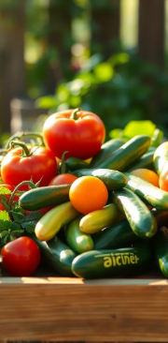
Business Plan
May 05, 2025
3. Products and Services
3.2 Unique Selling Proposition (USP)
Ikhwezi Farm’s competitive position is supported through a number of key competitive advantages that set them apart from other producers in the market. This include the following:
• Established Market Credibility: The farm maintains an established track record
of producing for leading retailers like Woolworths and Pick 'n Pay, together
with restaurant and hospitality customers.
• Premium Quality: Controlled-environment agriculture ensures consistent product quality, essential for high-end retail and hospitality buyers.
• Global GAP Certification: The farm had already attained Global GAP standing,
with plans for recertification soon after operations restart.
• Social and Environmental Impact: Ikhwezi Farm is 100 percent black female-
owned and differently-abled managed.
The business emphasizes youth and female employment and sustainable practice in order to lessen environmental footprint.
10

Slide 12


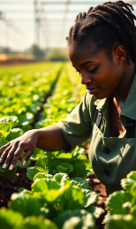
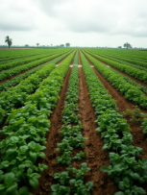
Business Plan
May 05, 2025
3. Products and Services
3.3 Value-Added Products and Diversification Strategies
Ikhwezi Farm will bring on-board additional-value products to cater to new consumer demands and boost profit margins. The planned projects are:
• Pre-packed, branded packs of vegetables for quality retailers
• Ready-to-use combinations of fresh herbs in pack
• Training and agri-tourism programs on-farm, capitalizing on the
educational and community contribution role of the farm
• Diversification into these products will bring on-board larger
markets and new revenue streams through bulk produce sales.
3.4. R&D Pipeline for Innovation
Ikhwezi Farm realizes that ongoing innovation is important in ensuring competitiveness as well as adapting to changing trends in the market. The business will:
• Pilot upgraded greenhouse management techniques for maximum crop yield with increased resource efficiency.
• Investigate organic methods of production of herbs and some vegetables.
• Invest in drip irrigation technology that saves water and advanced pest management systems.
• Implement year 2 onwards seedling propagation program in order to decrease input cost as well as enhance crop quality.
With agricultural consultants, input suppliers, and training institutions as partners, innovation will be an integral part of the farm's operations strategy.
11

Slide 13


22 On Sloane Proposal
May 05, 2025
4. Market Analysis
Ikhwezi Farm is involved in the production of high-value vegetables and herbs, which include baby marrow, tomatoes, lettuce, spring onions, as well as herbs like basil, wild rocket, coriander, and fennel. Knowing the market dynamics for all of them is imperative for planning strategically as well as positioning. This chapter offers an elaborate description of the local as well as the export markets for these crops, with the focus being on market sizes, trends, as well as opportunities.
4.1 Industry Overview
The fresh produce business in South Africa is an important driver of the country's economy with the fresh vegetables market producing USD 3.54 billion in 2020 and estimated to grow to USD 3.90 billion in 2028. The country's varied climatic conditions and modern agricultural methods make year-round production of crops possible, thereby establishing South Africa as an important player in both domestic and foreign markets.
Execution Plan
4.2 Market Trends and Growth Drivers
There are several trends driving the demand for fresh produce in South Africa:
· Health Awareness: Growing health consciousness is propelling demand for fresh vegetables as well as herbs.
· Urban dwellers are demanding easy access to fresh fruits and vegetables, driving retail sales.
· Export Opportunities: The positive climate in South Africa and its potential for production provide opportunities for exporting to areas with unfavorable conditions for cultivation.
The trends open doors for Ikhwezi Farm to increase its market coverage and take advantage of increasing demand.
12

Slide 14
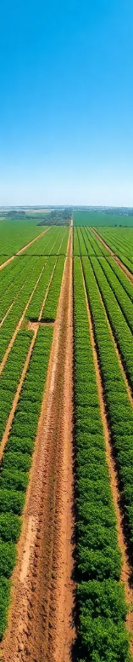
22 On Sloane Proposal
May 05, 2025
4. Market Analysis
4.3.1 Baby Marrow (Zucchini)
Local Market: Although precise figures for baby marrow are not available, it is included in the larger market of fresh vegetables, which, as stated, is an important market in the country.
Export Market: Baby marrow is among the vegetables that are exported to other countries, with 64% of the vegetable exports of South Africa in 2022 going to Africa.
4.3.2 Tomatoes
Domestic Market: Tomatoes are found in nearly every family in South Africa, so their consumption is the highest amongst all vegetables. The fresh vegetable market, with tomatoes as an important part of it, is worth USD 3.54 billion in 2020.
Export Market: Tomatoes from South Africa are shipped to the surrounding countries as well as farther away, with local farmers facing challenges in meeting the standards for exports.
4.3.3 Lettuce
Domestic Market: Lettuce is an intermediary vegetable in South Africa with both domestic consumption driven as well as the hotel industry demand.
Export Market: One of the vegetables being exported is lettuce, which contributes towards the earnings of vegetables exported from South Africa in total.rs.
13

Slide 15

22 On Sloane Proposal
May 05, 2025
4. Market Analysis
4.3.4 Spring Onions
Domestic Market: Spring onions enjoy wide usage in South African food, with consistent demand in retail and foodservice.
Export Market: Spring onions fall under the umbrella of vegetables exported to surrounding countries in line with the 64% vegetable exports mark in 2022.
4.3.5 Herbs (Basil, Wild Rocket, Coriander, Fennel)
Local Market: The local market for fresh herbs in South Africa earned USD 35.0 million in 2024 and is projected to grow to USD 57.8 million in 2030 with a CAGR of 8.7%. The highest revenue-generating product in 2024 was basil.
Export Market: Although limited export figures for herbs are available, increasing demand for fresh herbs around the world offers opportunities for producers in South Africa.
14

Slide 16

22 On Sloane Proposal
May 05, 2025
4. Market Analysis
4.4 Competitive Landscape
The South African fresh produce market is competitive with numerous players, including small-scale producers through large-scale enterprises. Ikhwezi Farm's emphasis on greenhouse production offers competitive advantage in terms of year-round production and quality control. The farm's dedication to sustainable methods of production as well as its potential for Global GAP certification can also set the farm apart in both domestic as well as international markets.
4.5 Market Opportunities and Barriers
Retail Partnerships: Reconnect with Woolworths, Pick ’n Pay to regain market share.
Export Demand: Target nearby countries lacking ideal farming conditions.
Product Diversification: Offer value-added items like packaged herbs and greens.
High Infrastructure Costs: Facility and equipment upgrades are expensive.
Export Compliance: Meet global quality and safety standards for export success.
Market Competition: Stay competitive through innovation and quality control.
15

Slide 17
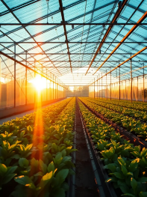
22 On Sloane Proposal
May 05, 2025
4. Market Analysis
4.6 Market segmentation data
According to historical trends and future growth prospects, the following market segmentation analysis represents customer growth rates for the next five years:
Potential Customers | Year 1 | Year 2 | Year 3 | Year 4 | Year 5 | CAGR (%)
Retail Chains | 10 | 11 | 12 | 13 | 14 | 8.78%
Restaurants | 20 | 24 | 29 | 35 | 42 | 20.38%
Informal Traders | 50 | 60 | 72 | 86 | 103 | 19.80%
Export Market | 5 | 6 | 7 | 8 | 9 | 15.83%
General Public | 100 | 130 | 169 | 220 | 286 | 30.04%
Total | 185 | 231 | 289 | 362 | 454 | 25.16%
16

Slide 18


Business Plan
May 05, 2025
5.Marketing and Sales Strategy
A strong marketing and sales strategy is critical for Ikhwezi Farm in order to attain stable income streams as well as long-term development. Drawing from past achievements as well as solid market relations, the business strategy centers on re-establishing supply arrangements, maximizing production in accordance with market needs, as well as adopting an efficient sales method. The strategy further provides for accommodating shifts in market conditions, such as changing consumer trends as well as competitive forces. The major elements of Ikhwezi Farm’s marketing as well as sales strategy are described here.
5.1 Marketing Plan
Marketing will promote Ikhwezi Farm’s brand, showcase product quality, and build customer loyalty by leveraging its established reputation and upgraded capacities.
Key actions include:
Direct Engagement: Reconnect with Woolworths and Pick ’n Pay to renew supply deals.
Brand Reinforcement: Highlight Global GAP certification, social impact, and product quality.
Strategic Networking: Attend agricultural events and business forums to gain new clients.
Community Marketing: Use social media and local events to attract and retain loyal customers.
17

Slide 19

Business Plan
May 05, 2025
5.Marketing and Sales Strategy
5.2 Branding and Product Positioning
A consistent and clear brand message will set Ikhwezi Farm apart from other competitors. The brand will have an association with quality, reliability, sustainability, as well as social impact.
Key positioning statements are:
· "High-quality greenhouse-grown vegetables and herbs that
can be trusted."
· "Empowering communities through sustainable agriculture."
· “Locally produced, globally accredited quality.”
Packaging, promotional materials, and all communication will demonstrate these values, supporting Ikhwezi Farm’s market standing.
18

Slide 20

22 On Sloane Proposal
May 05, 2025
5.Marketing and Sales Strategy
5.3 Sales Channels and Distribution Strategy
Sales channels will be diversified to reduce risk and maximize market coverage. Distribution will be designed for efficiency and responsiveness to client needs. Primary Sales Channels are:
· Retail Chains: Supplying directly to mainstream as well as upscale supermarkets.
· Restaurants and Hospitality: Forming supply agreements with hotels, restaurants, and catering services.
· Informal traders: Supplies large quantities of produce to vendors and small-scale retailers.
· Export markets: Collaborating with export agents and foreign buyers for targeting premium foreign markets.
· General Public: Selling produce through farm gate sales, farmers' markets, and future options for e-commerce.
Logistics will be managed to ensure timely deliveries, maintaining product freshness and quality.
19

Slide 21


22 On Sloane Proposal
May 05, 2025
5.Marketing and Sales Strategy
5.4 Customer Acquisition and Retention
Customer acquisition will focus on quality, pricing, service, and relationships through:
Leveraging existing customer ties.
Targeting new retailers and tourist outlets.
Encouraging word-of-mouth via product quality and community impact.
Customer retention will focus on:
Personalized service and regular communication.
Consistent product quality and reliable delivery.
Incentives for repeat and long-term customers.
.
5.5 Strategic Partnerships for Market Access
Partnerships will play a key role in scaling market access as well as competitive advantage. Ikhwezi Farm will continue collaborating with:
· Product placement and promotional support retail buyers.
· Agricultural advisors and market consultants for market knowledge and strategy refinement.
· Certification agencies for ensuring Global GAP compliance and pursuit of other certifications necessary for demand from other markets.
· Export agents and logistics providers for the handling of international distribution.
The partnerships will assist Ikhwezi Farm in overcoming market challenges, capturing growth opportunities, and establishing its credentials for reliability and innovation.
20

Slide 22

22 On Sloane Proposal
May 05, 2025
5.Marketing and Sales Strategy
5.6 Sales Forecast
The sales forecast is derived from historical performance, established market demand, and projected production capacity expansions. The projection is based on an annual production as well as sales rate of 10%, with production costs increasing 20% per year excluding labor.
To offset declining margins driven by increasing cost of production, the farm will:
· Boost operational efficiency through enhanced methods of production.
· Implement in-house propagation of the year-2 seeds to save input expenses.
· Create value-added items on order to fetch increased prices and capture extra market value.
Year | Projected Sales Growth | Notes
Year 1 | Baseline | Initial production ramp-up and re-engagement with previous clients.
Year 2 | +10% | Efficiency improvements, including in-house seedling production.
Year 3 | +10% | Market expansion and introduction of value-added products.
Year 4 | +10% | Scaling of net-house production and potential export growth.
Year 5 | +10% | Full production capacity utilization and expanded customer base.
21

Slide 23

Business Plan
May 05, 2025
6. Operational Plan
The operational plan outlines how Ikhwezi Farm will produce, manage, and deliver its premium vegetables and herbs efficiently and sustainably. A strong operational strategy is essential for ensuring consistent quality, controlling costs, and meeting market demand. This section covers Ikhwezi Farm’s production processes, current and planned infrastructure, supply chain and logistics, quality control measures, and sustainability practices. The farm’s operational model is built upon experience, proven methods, and an ambitious yet realistic approach to scaling.
6.1 Production Model and Greenhouse Technology
Ikhwezi Farm employs a controlled-environment agricultural model using greenhouse and tunnel infrastructure. This method enables year-round production, reduces vulnerability to adverse weather, and supports the cultivation of high-value crops with strict quality control.
The farm will produce the following crops:
· Baby Marrow
· Tomatoes
· Lettuce
· Spring Onion
· Herbs: Basil, Wild Rocket, Coriander, Fennel
22

Slide 24
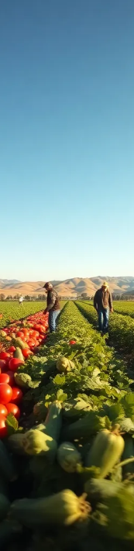
Business Plan
May 05, 2025
6. Operational Plan
Production will follow a carefully managed cropping schedule designed to optimize yields and meet market demand throughout the year. Modern drip irrigation systems will be used to maximize water efficiency and promote healthy plant growth. A production consultant will assist in implementing the crop program and improving cultivation practices over time. In addition, the farm plans to establish an in-house seedling propagation program from Year 2 to reduce reliance on external suppliers, lower input costs, and ensure seedling quality.
6.2 Current and Planned Infrastructure
Efficient production requires robust and well-maintained infrastructure. Ikhwezi Farm’s infrastructure is a combination of existing assets and planned upgrades.
Current infrastructure:
Tunnels: 8 units measuring 30m x 10m each (total 2,400m²) — requiring plastic sheeting and insect netting repairs.
Multi-span Greenhouse: 144m x 40m (5,760m²) — requiring structural repairs, plastic, and insect nets.
Packhouse: Global GAP compliant, requires minor repairs.
Boreholes: 3 units, supplying irrigation and drinking water. Equipment upgrades and a new reservoir are planned.
Land: 8.5 hectares, offering ample room for current production and future expansion.
23

Slide 25
Business Plan
May 05, 2025
6. Operational Plan
Planned infrastructure development:
Establishment of a 1-hectare net-house to expand production capacity.
Installation of new drip irrigation systems for all production areas.
Packhouse equipment upgrades, including a panneting machine, 5kg table scales, drying buckets, crates, and Meto-gun machines.
These infrastructure investments are included in the funding request and will enable the farm to meet production targets efficiently.
6.3 Supply Chain Management
A reliable and efficient supply chain is critical for maintaining product quality and meeting delivery commitments. Ikhwezi Farm’s supply chain strategy emphasizes close coordination between production, post-harvest handling, and distribution.
24

Slide 26
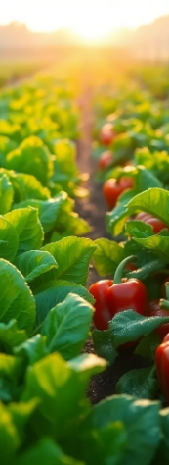

Business Plan
May 05, 2025
6. Operational Plan
Key supply chain components include:
Input sourcing: Seedlings (transitioning to in-house production), fertilizers, and packaging materials.
Harvesting and post-harvest handling: Onsite cleaning, grading, and packing in the farm’s Global GAP compliant packhouse.
Logistics: Direct deliveries to retail clients, restaurants, and informal traders. Export logistics will be managed through partnerships with experienced logistics providers.
Inventory management: Careful scheduling to minimize waste and ensure product freshness.
The supply chain will be overseen by the farm’s management team, with input from consultants to optimize efficiency and quality.
6.4 Sustainability and Environmental Stewardship
Ikhwezi Farm prioritizes sustainability to reduce its environmental impact and support social growth.
Key practices include:
Water Conservation: Drip irrigation to lower water usage.
Pest Management: Eco-friendly pest control to reduce chemicals.
Energy Efficiency: Prioritize energy-saving upgrades.
Social Impact: Employ and train local youth and women.
The farm will also renew its Global GAP certification to reaffirm its sustainability commitment.
25

Slide 27
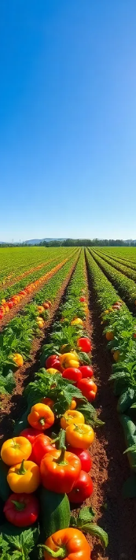
Business Plan
May 05, 2025
6. Operational Plan
6.5 Quality Assurance and Certifications
Delivering consistently high-quality produce is essential for customer retention and brand reputation. Ikhwezi Farm follows strict quality control protocols at every stage of the production and supply process.
Key quality assurance measures:
Crop monitoring: Regular inspection and management to ensure healthy growth and prevent quality issues.
Post-harvest quality checks: Grading and sorting to meet client specifications.
Compliance standards: Adherence to Global GAP standards for production, handling, and food safety.
Record keeping: Detailed documentation to ensure traceability and compliance with both local and export requirements.
By prioritizing quality, Ikhwezi Farm aims to exceed customer expectations and maintain a competitive edge in the market.
26

Slide 28
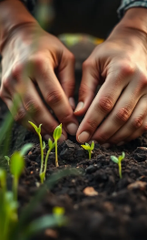
Business Plan
May 05, 2025
7. Human Resources
A clear and effective organizational structure is vital to ensure efficient operations, clear lines of responsibility, and accountability. At Ikhwezi Farm, the management model integrates experienced leadership, operational personnel, and external advisors to support specialized areas such as financial management, compliance, and agricultural consultancy. This section provides an overview of the organizational chart, roles and responsibilities, staffing plans, and human resource development strategies that will support the farm’s successful operations and growth.
7.1 Organizational Chart
The organizational structure has been designed to reflect both current operational requirements and the farm’s planned growth trajectory. It combines a lean core team with the flexibility to scale up personnel as production increases.
Key Positions:
Director / CEO: Ms. Sindisiwe Sabela
Successor / Deputy Director: Kuhle
Farm Manager: To be appointed
Agricultural Consultant: External advisor (Henry, as identified in previous plans)
Accounting Firm: External service provider
Permanent Farm Workers: Initial team of 5 employees
· Temporary Laborers: Hired as needed for peak production and harvesting periods
27

Slide 29

Business Plan
May 05, 2025
7. Human Resources
7.2 Key Roles and Responsibilities
Each team member and partner plays a critical role in the daily operations and strategic management of the farm.
Director / CEO (Sindisiwe Sabela): Provides overall leadership, oversees production planning, manages key client relationships, and leads marketing efforts.
Deputy Director (Kuhle): Learns all aspects of business management under mentorship and supports operational decisions, preparing for succession.
Farm Manager: Manages day-to-day farming operations, coordinates labor, implements crop production schedules, and ensures quality control.
Agricultural Consultant: Provides expert advice on crop production, infrastructure optimization, and regulatory compliance.
Accounting Firm: Manages financial reporting, bookkeeping, tax compliance, and financial planning.
Farm Workers: Handle planting, crop maintenance, harvesting, and initial post-harvest processing.
Temporary Staff: Support the farm workers during high-demand periods.
28

Slide 30
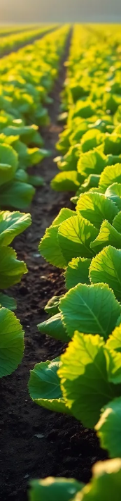
Business Plan
May 05, 2025
7. Human Resources
7.3 Staffing Plan
Ikhwezi Farm’s staffing strategy is designed to balance operational efficiency with flexibility. A core team will ensure consistent farm management, while seasonal labour will be used to manage cost-effectively during peak periods.
Year 1 Staffing Plan:
5 permanent staff for essential operational roles.
Consultant(s) for agricultural expertise and market strategy.
Outsourced accounting firm for financial management.
Temporary workers hired during peak production times.
Staffing Growth Plan:
As production increases and value-added activities expand, the farm will gradually increase its permanent workforce and may establish dedicated roles in sales, logistics, and compliance.
29

Slide 31
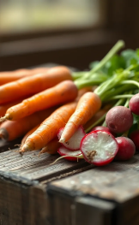
Business Plan
May 05, 2025
7. Human Resources
7.4 Skills Development and Training
Developing human capital is a central component of Ikhwezi Farm’s long-term success strategy. Training programs will focus on improving technical farming skills, quality assurance practices, and safety protocols.
Training initiatives will include:
On-the-job training led by the Farm Manager and Agricultural Consultant.
Formal skills development through partnerships with agricultural training providers.
Compliance training to meet Global GAP standards.
Leadership mentorship for Kuhle as part of the succession plan.
In line with Ikhwezi Farm’s social mission, priority will be given to hiring and training youth and women from local communities, providing them with skills that promote long-term employability and self-sufficiency.
30

Slide 32
Business Plan
May 05, 2025
7. Human Resources
7.5 Employment Equity and Local Impact
Ikhwezi Farm is committed to promoting diversity, equity, and community empowerment. As a 100% black woman-owned and differently-abled business, the company prioritizes inclusive hiring practices and strives to create opportunities for historically disadvantaged groups.
Key employment equity objectives:
· Maintain gender-balanced hiring practices.
· Empower differently-abled individuals by offering meaningful employment opportunities.
· Partner with local organizations to recruit, train, and retain employees from nearby communities.
By aligning its human resource practices with its social impact goals, Ikhwezi Farm not only meets operational needs but also contributes to the broader goals of social and economic development.
.
30

Slide 33
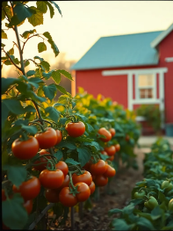
Business Plan
May 05, 2025
8. Financial Plan
8.1 Start-Up / Expansion Capital Requirements
To restore the farm’s infrastructure and expand production, Ikhwezi Farm requires a significant capital investment. These funds will cover the cost of repairing and upgrading essential production infrastructure, acquiring equipment, securing planting materials, and supporting initial operational expenses.
The farm is seeking R [to be finalized] in external funding. The loan will be collateralized by the farm’s fixed assets, supported by the personal integrity and proven track record of the owner, Sindisiwe Sabela, as well as commitments from technology partners and market buyers.
Item | Unit Cost (ZAR) | Quantity | Total Cost (ZAR)
Tunnel repair | 138,758 | 1 | 138,758
Packhouse repairs | 62,000 | 1 | 62,000
Borehole equipment | 13,000 | 1 | 13,000
Packhouse panneting machine | 6,000 | 1 | 6,000
Packhouse 5kg table scales | 4,000 | 1 | 4,000
Packhouse drying buckets | 400 | 20 | 8,000
Packhouse crates | 90 | 200 | 18,000
Packhouse Meto-gun machines | 500 | 3 | 1,500
Baby cabbage seedlings (4000/tunnel) | [To be added] | [To be confirmed] | [To be calculated]
Irrigation system upgrades | [To be added] | [To be confirmed] | [To be calculated]
Note: Final figures for seedling and irrigation costs will be confirmed in the detailed funding proposal.
31

Slide 34
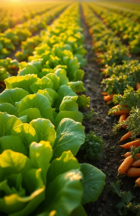
Business Plan
May 05, 2025
8. Financial Plan
8.2 Detailed Use of Funds
The requested capital will be allocated as follows:
Infrastructure Repairs and Upgrades: Tunnels, greenhouse, packhouse, borehole equipment.
Equipment Acquisition: Packing and grading equipment, scales, and crates.
Production Inputs: Seedlings, fertilizers, and irrigation infrastructure.
Operational Costs: Recruitment, training, certification renewal, and initial working capital.
This phased investment approach ensures that critical infrastructure is operational first, followed by scaling production and expanding market engagement.
8.3 Revenue Streams and Financial Projections (3-5 years)
Ikhwezi Farm’s revenue model is built on the sale of fresh vegetables and herbs through diversified market channels, including retail chains, restaurants, informal traders, export buyers, and direct sales to the public.
Key revenue streams:
Bulk sales to supermarkets and restaurants.
Sales to informal traders.
Direct farm gate and market sales.
Potential value-added product sales in later years.
32

Slide 35
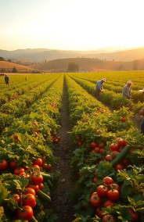
Business Plan
May 05, 2025
8. Financial Plan
Growth assumptions:
Annual production growth of 10%.
Production cost growth of 20%, excluding labour.
Efficiency improvements from Year 2, including in-house seedling production.
Profitability:
Break-even: Projected within the first 9 months.
Profit growth: Expected to increase by approximately 10% per annum from Year 2 onward.
8.4 Profit and Loss Forecast
The farm anticipates steady revenue growth, driven by increased production capacity and expanding market access. Profit margins will initially be constrained by start-up costs but will improve as operational efficiencies are implemented.
A detailed year-by-year Profit and Loss Statement will be included in the final financial annexures, reflecting projected revenues, costs of goods sold, gross profit, operating expenses, and net profit.
33

Slide 36
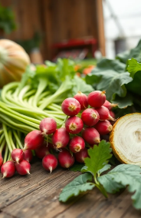
Business Plan
May 05, 2025
8. Financial Plan
8.5 Cash Flow Projections
Maintaining positive cash flow is critical for operational stability. Cash flow projections account for:
Seasonal production cycles.
Customer payment terms.
Ongoing capital expenditure requirements.
Working capital needs.
A monthly cash flow forecast for the first 24 months will be developed to guide financial management and support funding disbursement schedules.
8.6 Break-Even Analysis
Based on projected production volumes, pricing, and cost structures, Ikhwezi Farm expects to reach its break-even point within the first 9 months of operation. Early break-even performance will be supported by:
Pre-committed market demand from previous clients.
Efficient cost control.
Phased production scaling.
34

Slide 37
Business Plan
May 05, 2025
8. Financial Plan
8.7 Return on Investment (ROI) and Funders’ Value Proposition
Funders can expect a compelling combination of financial return and social impact. Ikhwezi Farm offers:
Positive cash flow within the first year.
Strong revenue growth prospects driven by diversified markets.
Social impact through job creation, skills development, and empowerment of youth and women.
Environmental sustainability through efficient resource use and compliance with Global GAP standards.
These factors contribute to a low-risk, high-impact investment opportunity aligned with both financial and developmental objectives.
35

Slide 38

Business Plan
May 05, 2025
9. Risk Assessment and Migitation
Every agricultural enterprise faces a variety of risks that can impact operations, financial performance, and market access. For Ikhwezi Farm, understanding potential risks and proactively implementing mitigation strategies is essential for ensuring business resilience and protecting investor interests. This section identifies the key risks across business, operational, financial, and environmental categories, and outlines the comprehensive measures the farm will employ to minimize or manage these risks effectively.
9.1 Business and Market Risks
Market dynamics can fluctuate due to changes in consumer demand, competition, and macroeconomic factors. These risks can affect sales volumes, pricing, and profitability.
Key Risks:
Volatility in market demand or consumer preferences.
Increased competition from new or existing producers.
Price fluctuations for fresh produce in both domestic and export markets.
Mitigation Strategies:
Diversification of customer base across retail, hospitality, informal trade, and export markets.
Flexibility in crop selection to respond to changing market trends.
Building long-term supply contracts where possible to stabilize demand and pricing.
36

Slide 39

Business Plan
May 05, 2025
9. Risk Assessment and Migitation
9.2 Operational Risks
Operational risks stem from production processes, infrastructure reliability, and workforce management. Any disruption in these areas can lead to production delays or quality issues.
Key Risks:
Infrastructure breakdowns or delays in facility upgrades.
Labor shortages or high turnover.
Pest infestations or crop diseases impacting yields.
Mitigation Strategies:
Phased infrastructure repairs and upgrades, with a maintenance plan.
Competitive wages and continuous training programs to retain skilled workers.
Integrated pest management (IPM) practices and close monitoring of crop health.
9.3 Financial Risks
Financial stability is crucial for sustaining operations, managing growth, and meeting investor expectations. Financial risks can arise from cash flow shortfalls, cost overruns, or changes in funding conditions.
37

Slide 40
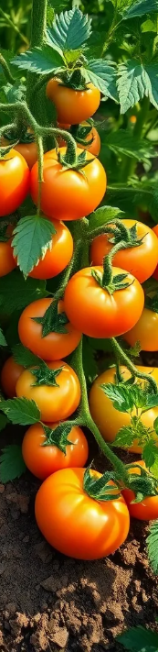
Business Plan
May 05, 2025
9. Risk Assessment and Migitation
Key Risks:
Initial capital shortfall or delays in securing funding.
Rising input costs exceeding projections.
Delayed customer payments impacting cash flow.
Mitigation Strategies:
Detailed cash flow planning with conservative assumptions.
Early engagement with lenders and investors to secure capital.
Establishing credit policies and negotiating payment terms with buyers
9.4 Environmental and Regulatory Risks
Risks:
Drought or water shortages impacting irrigation.
Changes in regulations or export rules.
Non-compliance with certifications like Global GAP.
Mitigations:
Use water-efficient drip irrigation.
Regularly review regulations and compliance needs.
Engage early with certifiers to renew certifications on time.
38

Slide 41

Business Plan
May 05, 2025
9. Risk Assessment and Migitation
Mitigations:
Use water-efficient drip irrigation.
Regularly review regulations and compliance needs.
Engage early with certifiers to renew certifications on
9.5 Mitigation Strategy Summary
Ikhwezi Farm’s approach to risk management integrates preventive, corrective, and adaptive measures. By combining proactive planning, ongoing monitoring, and expert guidance, the farm aims to minimize risk exposure and respond swiftly to any challenges that arise. Regular risk reviews will be conducted as part of the farm’s management process to ensure continued resilience and adaptability.
39

Slide 42
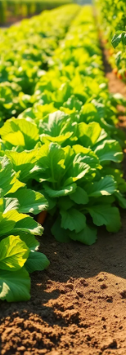

Business Plan
May 05, 2025
10. Social, Environmental & Economic Impact
Beyond profitability, Ikhwezi Farm is committed to delivering positive social, environmental, and economic outcomes. As a black woman-owned and differently-abled enterprise, the farm operates with a deep sense of responsibility toward its employees, community, and the broader South African agricultural sector. This section outlines how Ikhwezi Farm’s operations generate measurable impacts aligned with national development priorities and global sustainability goals. These outcomes enhance the business’s value proposition and appeal to socially responsible investors and partners.
10.1 Job Creation and Community Development
Ikhwezi Farm has a strong history of creating employment and supporting community development. The farm’s inclusive hiring practices prioritize the recruitment of youth, women, and individuals from disadvantaged backgrounds. By providing meaningful employment, skills training, and leadership opportunities, Ikhwezi Farm contributes directly to local economic development and social empowerment.
Key Community Impact Highlights:
Initial creation of 5 permanent jobs, with additional seasonal employment during peak periods.
A commitment to mentoring and developing young agricultural professionals, including the active succession planning for Kuhle.
Plans to revive the farm’s previous seedling donation and home garden support programs for community members.
Future training programs to teach sustainable farming techniques to local youth and women.
This employment strategy not only addresses unemployment but also builds a skilled local agricultural workforce.
40

Slide 43

Business Plan
May 05, 2025
10. Social, Environmental & Economic Impact
10.2 Environmental Sustainability Initiatives
Environmental stewardship is integrated into every aspect of Ikhwezi Farm’s operations. Greenhouse farming inherently reduces the environmental impact compared to open-field agriculture by optimizing resource use and minimizing waste.
Key Environmental Practices:
Water Conservation: The use of drip irrigation systems significantly reduces water usage.
Pest Management: The farm employs integrated pest management (IPM) to minimize chemical pesticide use.
Waste Reduction: Efficient production planning reduces crop waste, while organic waste will be composted or responsibly disposed of.
Infrastructure Rehabilitation: Repairs and upgrades are designed to improve energy and resource efficiency.
By renewing its Global GAP certification, the farm will also formalize its commitment to sustainable production and food safety standards.
41

Slide 44

Business Plan
May 05, 2025
10. Social, Environmental & Economic Impact
10.3 Contribution to South Africa’s Agricultural and Food Security Goals
Ikhwezi Farm aligns with South Africa’s national goals of promoting food security, supporting smallholder farmers, and driving inclusive growth in the agricultural sector. By producing high-quality, nutritious vegetables and herbs, the farm helps to meet the increasing demand for fresh produce among local consumers and contributes to dietary diversity.
Key Economic and Food Security Contributions:
Increasing supply of affordable, fresh produce to both high-end and informal markets.
Supporting South Africa’s agricultural development objectives, including black empowerment and land reform initiatives.
Potential to expand into export markets, contributing to the country’s trade balance and foreign exchange earnings.
Ikhwezi Farm’s operations create value across the supply chain — from farm workers and local input suppliers to retailers and end consumers.
42

Slide 45

22 On Sloane Proposal
May 05, 2025
10. Social, Environmental & Economic Impact
10.4 Alignment with ESG (Environmental, Social, Governance) Principles
Environmental, Social, and Governance (ESG) criteria are increasingly important to investors and buyers alike. Ikhwezi Farm’s business model and practices demonstrate strong ESG alignment.
· Environmental: Sustainable farming practices, water conservation, and minimal chemical use.
· Social: Inclusive employment, youth and women empowerment, and community development initiatives.
· Governance: Transparent management, professional financial oversight by an external accounting firm, and adherence to industry standards such as Global GAP.
· By embedding ESG principles into its core strategy, Ikhwezi Farm not only meets market expectations but also enhances its resilience and long-term competitiveness.
43

Slide 46

22 On Sloane Proposal
May 05, 2025
11. Growth and Expansion Roadmap
A phased roadmap will guide Ikhwezi Farm’s growth, showing funders how capital leads to production increases, market expansion, better efficiency, and stronger social impact. This ensures sustainable, manageable, and financially sound progress
.11.1 Short-Term Goals (Year 1 to Year 2)
The first two years of operations will focus on restoring production capacity, rebuilding customer relationships, and establishing a solid operational and financial foundation. This phase will also set the stage for long-term growth by completing critical infrastructure upgrades and securing necessary certifications.
Key Short-Term Initiatives:
Complete repairs and upgrades to tunnels, greenhouse structures, irrigation systems, and the packhouse.
Re-engage previous retail clients (Woolworths, Pick ’n Pay) and confirm supply agreements.
Ramp up production of the core crop portfolio: Baby Marrow, Tomatoes, Lettuce, Spring Onion, Basil, Wild Rocket, Coriander, and Fennel.
Hire and train the initial team of permanent farm workers.
Renew Global GAP certification.
Launch direct-to-consumer sales through farm gate outlets and community markets.
Pilot the in-house seedling propagation program.
44

Slide 47

Business Plan
May 05, 2025
11. Growth and Expansion Roadmap
11.2 Medium-Term Goals (Year 3 to Year 5)
During this phase, Ikhwezi Farm will focus on scaling production, expanding market presence, improving operational efficiencies, and introducing value-added products. Growth will be driven by both volume increases and the development of new revenue streams.
Key Medium-Term Initiatives:
Expand production capacity by adding the proposed 1-hectare net-house.
Increase sales volumes by 10% annually, as outlined in the sales forecast.
Introduce value-added products, such as pre-packaged vegetable selections and fresh herb packs.
Develop formal partnerships with hospitality groups and additional retail chains.
Expand training and community engagement programs.
Explore export opportunities for herbs and vegetables, targeting neighbouring African countries and niche international markets.
Invest in advanced monitoring technology for improved crop management and resource efficiency.
45

Slide 48

Business Plan
May 05, 2025
11. Growth and Expansion Roadmap
11.3 Long-Term Vision (Year 6 and Beyond)
Ikhwezi Farm’s long-term vision is to establish itself as a leading producer of high-quality, sustainable greenhouse produce in South Africa and a recognized exporter of premium vegetables and herbs. Growth will be aligned with market opportunities, financial capacity, and social impact goals.
Key Long-Term Objectives:
Achieve full production capacity utilization across greenhouse, tunnel, and net-house infrastructure.
Expand into additional high-value crops based on market demand and profitability.
Develop branded, premium value-added products for both local and export markets.
Deepen community development efforts by increasing local employment, expanding training programs, and supporting other smallholder farmers.
Pursue additional certifications or standards as required by evolving market and export requirements.
Maintain strong financial performance with sustainable profit growth and a diversified client base.
46

Slide 49

Business Plan
May 05, 2025
11. Growth and Expansion Roadmap
11.4 Growth Management Principles
To ensure that growth is sustainable and manageable, Ikhwezi Farm will adhere to key growth management principles:
Phased expansion to avoid overextension of resources.
Continuous market research to inform crop selection and product development.
Strong financial controls and forecasting to guide investment and operational decisions.
Partnership development to leverage expertise, market access, and technical support.
Commitment to ESG goals to ensure environmental stewardship, social responsibility, and transparent governance.
47

Slide 50

Business Plan
May 05, 2025
12. Miletones
Establishing clear milestones is essential for tracking progress, ensuring accountability, and demonstrating to funders that the business has a structured plan for implementation and scaling. Ikhwezi Farm has identified a series of operational, financial, and strategic milestones that will guide its growth trajectory over the next five years.
These milestones correspond to infrastructure upgrades, production targets, market engagement, and community impact objectives. Regular performance reviews will be conducted to monitor progress against these benchmarks.
48

Slide 51
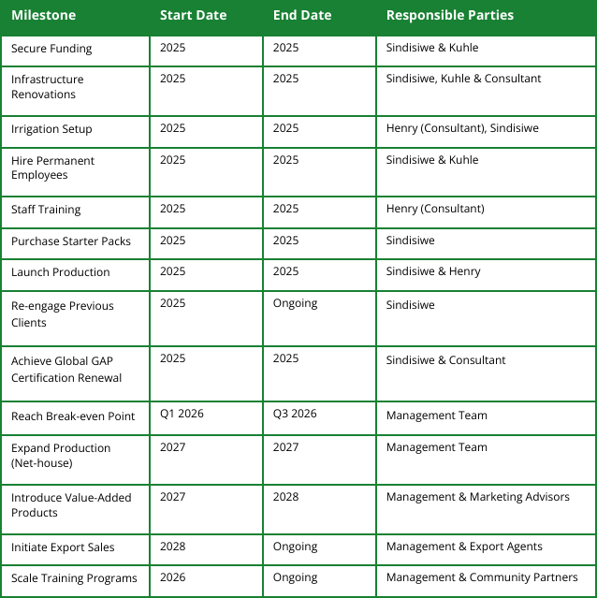
Business Plan
May 05, 2025
12. Miletones
12.1 Key Milestones and Timeline
The following table summarizes the primary milestones Ikhwezi Farm aims to achieve, including projected timelines and responsible parties.
Table 1: Ikhwezi Farm Key Milestones
Milestone | Start Date | End Date | Responsible Parties
Secure Funding | 2025 | 2025 | Sindisiwe & Kuhle
Infrastructure Renovations | 2025 | 2025 | Sindisiwe, Kuhle & Consultant
Irrigation Setup | 2025 | 2025 | Henry (Consultant), Sindisiwe
Hire Permanent Employees | 2025 | 2025 | Sindisiwe & Kuhle
Staff Training | 2025 | 2025 | Henry (Consultant)
Purchase Starter Packs | 2025 | 2025 | Sindisiwe
Launch Production | 2025 | 2025 | Sindisiwe & Henry
Re-engage Previous Clients | 2025 | Ongoing | Sindisiwe
Achieve Global GAP Certification Renewal | 2025 | 2025 | Sindisiwe & Consultant
Reach Break-even Point | Q1 2026 | Q3 2026 | Management Team
Expand Production (Net-house) | 2027 | 2027 | Management Team
Introduce Value-Added Products | 2027 | 2028 | Management & Marketing Advisors
Initiate Export Sales | 2028 | Ongoing | Management & Export Agents
Scale Training Programs | 2026 | Ongoing | Management & Community Partners
49

Slide 52
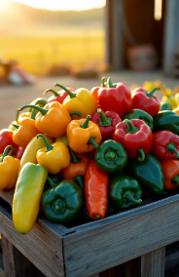
Business Plan
May 05, 2025
12. Miletones
12.2 Performance Monitoring and Reporting
Achieving these milestones will require disciplined project management and continuous performance monitoring. Ikhwezi Farm will establish a milestone review framework that includes:
Quarterly progress reports detailing operational achievements, financial performance, and market development.
Annual impact assessments covering job creation, environmental sustainability, and social development outcomes.
Stakeholder updates for funders, partners, and community stakeholders to ensure transparency and build trust.
Key performance indicators (KPIs) will be linked to each milestone, providing measurable criteria to assess success and inform any necessary adjustments.
12.3 Flexibility and Contingency Planning
While the farm is committed to meeting its milestones, flexibility is essential in agricultural ventures due to potential unforeseen circumstances such as weather events or market fluctuations. Ikhwezi Farm’s phased approach to growth and its strong risk management framework (as outlined in Section 9) will ensure that the business can adapt to changes while keeping long-term objectives in focus.
50

Slide 53

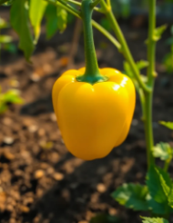

Business Plan
May 05, 2025
13. Conclusion
13. CONCLUSION AND CALL TO ACTION
Ikhwezi Farm represents a unique convergence of proven agricultural experience, market demand, and social impact. The farm’s revival and expansion are grounded in a robust operational plan, a diversified product portfolio, and an established track record of supplying premium markets.
More than just a farming venture, Ikhwezi Farm embodies empowerment, resilience, and sustainability — values that resonate with both commercial partners and development-focused investors. With the right funding, Ikhwezi Farm will not only generate solid financial returns but also create meaningful employment, promote environmentally responsible farming practices, and contribute to national food security and export growth.
Thank you for your interest!
51

Slide 54
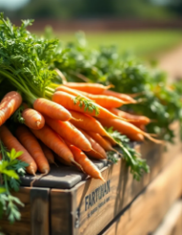
Business Plan
May 05, 2025
13. Conclusion
13.1 Value Proposition for Funders
Funders and investors are presented with a compelling opportunity to support a business that combines financial viability with measurable social and environmental benefits.
Key value propositions include:
Established Market Access: Proven history of supplying high-end retail chains and restaurants, with prior clients willing to re-engage.
Growth Potential: Clear roadmap for production scaling, value-added product development, and market expansion, including exports.
Social Impact: Creation of jobs, skills development, and community empowerment, particularly for youth and women.
Sustainability: Commitment to environmentally friendly farming practices and Global GAP certification.
Strong Management: Experienced leadership, supported by consultants and professional advisors, with a legally documented succession plan.
Thank you for your interest!
52

